Slide 1
Logic Building and Problem Solving
PGDAC
By Swati From CDAC,Noida

Slide 2
Building Logic
Logic building skills are essential for programmer and if one wishes to be a programmer, he or she needs to keep getting better at developing logic.
Complex and sophisticated algorithms require advanced logic in order for programmers to work with them.
Programming languages are important and crucial, however, one must learn about data structures, algorithms and programming paradigms.

Slide 3
Enhancing Logic Building Skills
Practice writing a lot of code:To be a good programmer, one needs to write hours and hours of code, practising the same problems and algorithms over and over again.
Check solutions by other people:There is no point in wasting your time stuck in a problem, it is simply better to check the solution out, learn from it and then implement it.
Use a pen and paper to work out solutions:Breaking down solutions and thinking about them is much easier when programmers write them down.
Keep learning new things:Programmers must expand their knowledge and logic building skills by tackling new topics and challenges.

Slide 4
Be consistent: Programmers should not keep any gap between practising.
Face problems head-on: One must not give up or lose confidence in himself or herself when facing this kind of situation.
Don’t lose motivation: The only way to get better at building logic is through experience and a deep understanding of how logic functions.
Follow Step-by-Step Approach

Slide 5
Tips to Build Better Logic When Programming
Write cleaner and lesser code
Learn programming paradigms such as object-oriented programming.
Solve new problems every day.
Divide problems into smaller portions or chunks and understand how to apply logic for each chunk.
Think about logic and the different applications of logic in programming.
Build and deploy as many projects as possible.

Slide 6
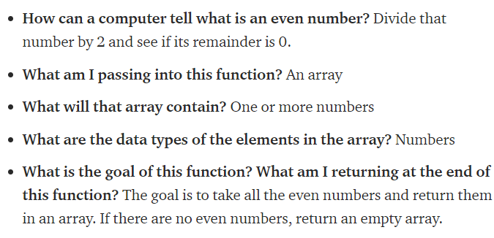
Problem Solving Process
Read the problem at least three times (or however many makes you feel comfortable)
some questions that run through my mind:

Slide 7
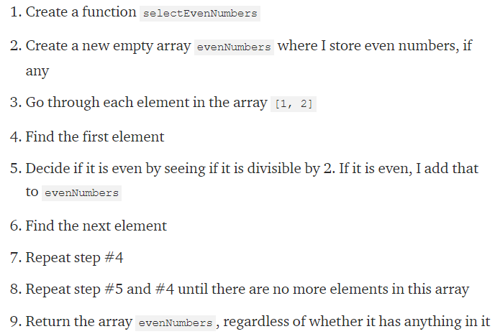
Simplify and optimize your steps

Slide 8
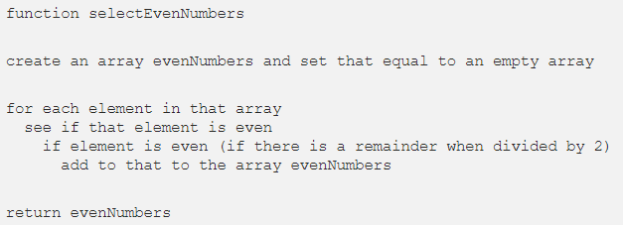
Write pseudocode
Don’t get caught up with the syntax. Focus on the logic and steps.
Translate pseudocode into code and debug
Simplify and optimize your code
Debug
catch any syntax errors or gaps in logic sooner
Write useful comments

Slide 9
six steps must be followed to solve a problem using computer.
Problem Analysis defining a problem and decomposing overall system into smaller parts to identify possible inputs, processes and outputs associated with the problem.
Program Design - Algorithm, Flowchart and Pseudocode
Coding The coding process can be done in any language (high level and low level).
Compilation and Execution The translation process is carried out by a compiler/interpreter (for high level language) or an assembler (for assembly language program).
Debugging and Testing Systematic process during program development cycle to avoid errors in the program(Syntax , Logical and Run Time Error) Testing to verify that whether the completed software package functions or works according to the expectations
Program Documentation ontains the necessary information that a programmer requires to update and maintain the program.

Slide 10
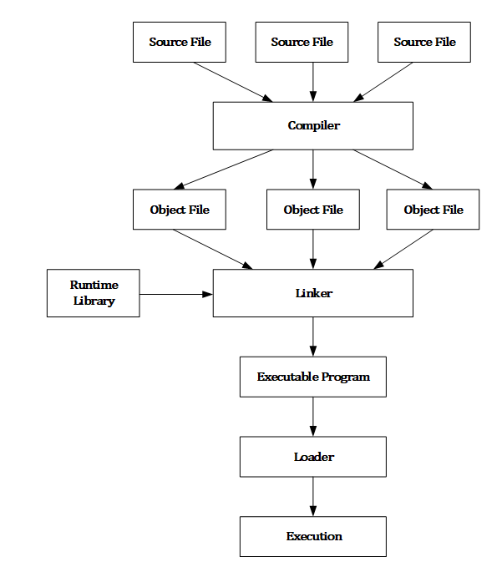
Compilation process

Slide 11
1. steps required for an activity ‘riding a bicycle’:
1)remove the bicycle from the stand
2) sit on the seat of the bicycle
3) start peddling
4) use breaks whenever needed
5) stop on reaching the destination.

Slide 12
2. : Write an algorithm to display the sum of two numbers entered by user, using pseudocode
Pseudocode for the sum of two numbers will be:
input num1
input num2
COMPUTE Result = num1 + num2
PRINT Result

Slide 13
3.Algorithm to calculate area and perimeter of a rectangle, using both pseudocode
input length
input breadth
compute Area = length * breadth
print Area
compute Perim = 2 * (length + breadth)
print Perim

Slide 14
Checking eligibility for voting
• If age is greater than or equal to 18, the person is eligible to vote •
If age is less
Algorithm to check whether a number is odd or even. than 18, the person is not eligible to vote
Input: Any number •
Process: Check whether the number is even or not
Output: Message “Even” or “Odd”
PRINT "Enter the Number“---- INPUT number ----IF number MOD 2 == 0
THEN
PRINT "Number is Even" ELSE PRINT "Number is Odd"

Slide 15
categorise a person as either child (=13 but =20),based on age specified
INPUT Age
if Age < 13
then
PRINT "Child"
else if Age < 20
then PRINT "Teenager"
else PRINT "Adult"

Slide 16
print all multiples of 5 between 10 and 25 (including both 10 and 25)
Suppose you are collecting money for something. You need ` 200 in all. You ask your parents, uncles and aunts as well as grandparents. Different people may give either ` 10, ` 20 or even ` 50. You will collect till the total becomes 200. Write the algorithm
find the greatest among two different numbers entered by the user
accepts four numbers as input and find the largest and smallest of them.

Slide 17
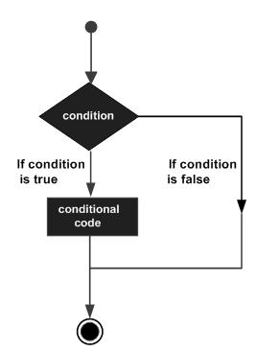
Decision making
Decision making is the process of making choices by identifying a decision, gathering information, and assessing alternative resolutions.

Slide 18
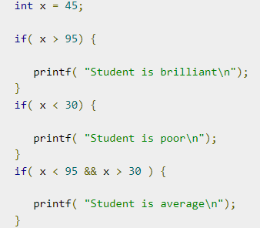
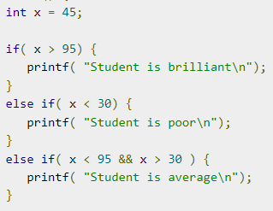

Slide 19
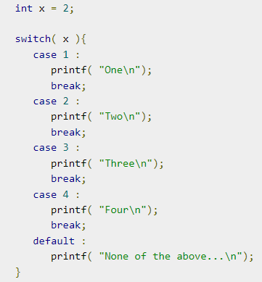
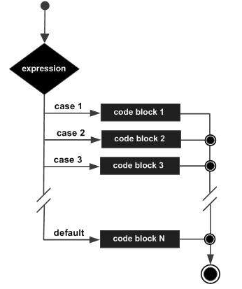
switch

Slide 20
Control statements
A control statement is a statement that determines whether other statements will be executed.
There are four types of control statements in C:
Decision making statements/Selection statements-if else, nested if, switch
Iteration statements- For loop and While loop
Jump statements- Break, Continue

Slide 21
Modular Programming
Modular Programming allows development to be divided by splitting down a program into smaller programs in order to execute a variety of tasks.
A module is a software component or part of a program that contains one or more routines. One or more independently developed modules make up a program
A function is a block of organized code that is used to perform a single task. They provide better modularity for your application and reuse-ability.
A function is a collection of statements grouped together to do some specific task.

Slide 22
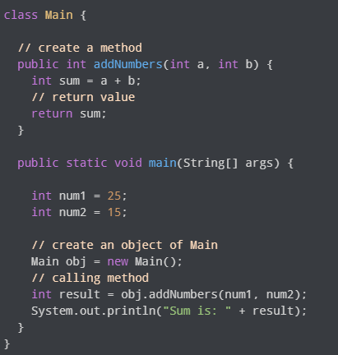

Slide 23
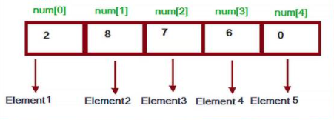
Arrays
An array is a series of memory locations – or 'boxes' – each of which holds a single item of data, but with each box sharing the same name. All data in an array must be of the same data type
An array is a group (or collection) of same data types. For example an int array holds the elements of int types while a float array holds the elements of float types.
a collection of elements of the same type placed in contiguous memory locations

Slide 24
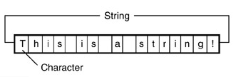
Strings
sequence of characters, either as a literal constant or as some kind of variable.

